Slide 1
IMDB Movie Analysis
The presentation introduces IMDb Movie Analysis, emphasizing insights from top-rated films and the importance of IMDb ratings. It covers methodology, popular genres, top-rated movies, director and actor influences, budget analysis, time trends, and user reviews, concluding with recommendations for filmmakers. The audience is invited to engage in a Q&A session.
By Yogamariappan.

Slide 2
Problem Statement
The dataset provided is related to IMDB Movies. A potential problem to investigate could be: "What factors influence the success of a movie on IMDB?" Here, success can be defined by high IMDB ratings. The impact of this problem is significant for movie producers, directors, and investors who want to understand what makes a movie successful to make informed decisions in their future projects. Consider this as an open ended question and come up with more analysis points. Anyway, here are some of the analysis ideas given to you.

Slide 3
Data
colour: The colour type of the movie (e.g., colour or black and white)
director name: The name of the director of the movie.
num_critic_for_reviews: The number of critic reviews for the movie.
duration: The duration or length of the movie in minutes.
director_facebook_likes: The number of Facebook likes for the director's page.
actor_3_facebook_likes: The number of Facebook likes for the third actor in the movie.
actor_2_name: The name of the second actor in the movie.
actor_1_facebook_likes: The number of Facebook likes for the first actor in the movie.
gross: The gross revenue or earnings of the movie.
genres: The genre or genres of the movie.
actor_1_name: The name of the first actor in the movie.
movie title: The title of the movie.
num_voted_users: The number of users who voted for the movie.
cast_total_facebook_likes: The total number of Facebook likes for the entire cast.
movie_imdb_link: The IMDb link for the movie.
num_user_for_reviews: The number of user reviews for the movie.
language: The language in which the movie is made.
country: The country where the movie was produced.
content rating: The content rating of the movie (e.g., PG, R, etc.).
budget: The budget or production cost of the movie.
title year: The year when the movie was released.
actor_2_facebook_likes: The number of Facebook likes for the second actor in the movie.
imdb_score: The IMDb score or rating of the movie.
aspect ratio: The aspect ratio of the movie (width to height ratio).
movie_facebook_likes: The number of Facebook likes for the movie's page.
actor_3_name: The name of the third actor in the movie.
facenumber_in_poster: The number of faces in the movie poster.
plot_keywords: Keywords describing the plot or themes of the movie.

Slide 4
Data Cleaning
This step involves preprocessing the data to make it suitable for analysis. It includes handling missing values, removing duplicates, converting data types if necessary, and possibly feature engineering.
data types
All column data types are accurate, except for the "tittle year" column, which is currently designated as an float type. To rectify this, convert the float type to datetime.
data['title_year'] = pd.to_datetime(data['title_year'])
handling missing values
Numerous columns contain null values in my dataset. To address this, I opted for imputation by utilizing the mean for numerical columns and the mode for categorical columns. I chose this approach instead of removing the data, as only 10% of the values were missing.
categorical_columns = ['color', 'director_name', 'actor_2_name', 'actor_1_name', 'actor_3_name', 'plot_keywords', 'language', 'country', 'content_rating']
for column in categorical_columns:
data[column].fillna(data[column].mode()[0], inplace=True)
numerical_columns = ['num_critic_for_reviews', 'duration', 'director_facebook_likes', 'actor_3_facebook_likes',
'actor_1_facebook_likes', 'gross', 'facenumber_in_poster', 'budget',
'actor_2_facebook_likes', 'aspect_ratio']
for column in numerical_columns:
# Check if the column is numeric before filling missing values
if pd.api.types.is_numeric_dtype(data[column]):
data[column].fillna(data[column].mean(), inplace=True)
else:
print(f"S
kipping non-numeric column: {column}")

Slide 5
I removed duplicate records from the dataset.
I performed data cleaning using Google Colab. After completing the cleaning process, I stored the refined data, which I then imported into Tableau for further analysis.
Feature engineering
I conducted feature engineering by introducing two new columns in the dataset. The first column, 'profit,' represents the difference between gross earnings and the budget of each movie. The second column, ‘nu
m_genres,' captures the number of genres associated with each movie by counting the genres separated by ‘|’
data['profit'] = data['gross'] - data['budget’]
data['num_genres'] = data['genres'].apply(lambda x: len(x.split('|')))

Slide 6
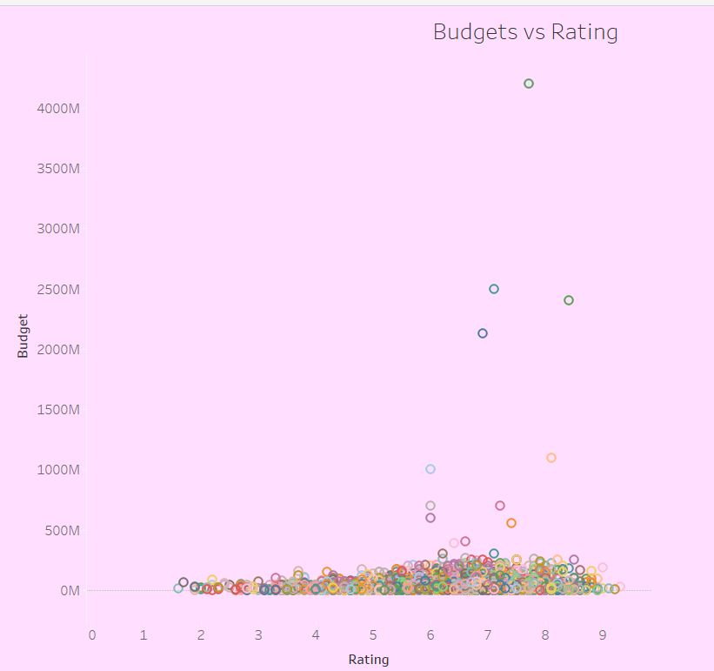
Why do movies with higher budgets tend to have higher ratings?
Upon analysis, I observed that there is no correlation between higher budgets and higher ratings. Contrary to expectations, movies with lower budgets tended to receive higher rating.

Slide 7
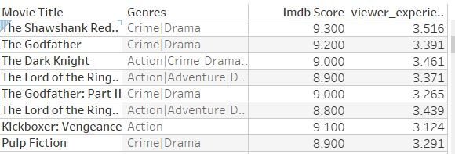
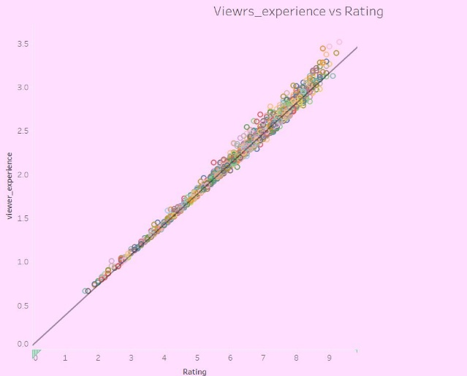
Why does an enhanced viewer experience lead to higher ratings?
I found a strong correlation between viewer experience and higher ratings; as viewer numbers increased, ratings also tended to rise. In terms of genres, crime, drama, and action genres consistently garnered high ratings. However, it's worth noting that this correlation did not extend to budget and gross, as some highly-rated movies had lower profits and gross earnings.
([Imdb Score] + ([Num User For Reviews] / {FIXED : MAX([Num User For Reviews])}) + ([Duration] / {FIXED : MAX([Duration])})) / 3

Slide 8
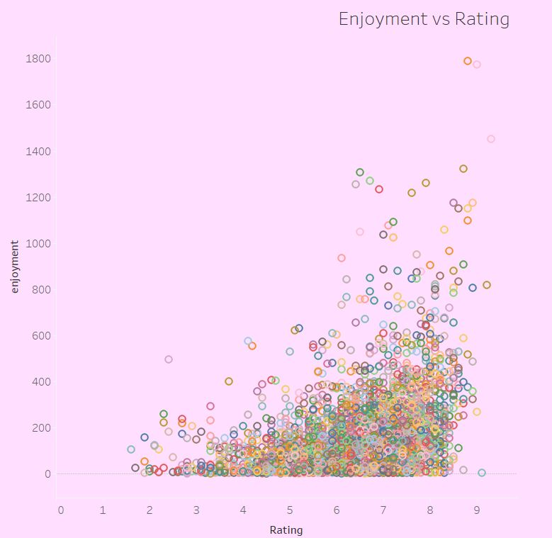
Why are viewers more likely to rate a movie highly if they enjoyed watching it?
There is a positive relationship between enjoyment and ratings. According to my analysis, a significant portion of viewers enjoyed movies spanning multiple genres, including action, adventure, drama, and fantasy.
([Imdb Score] + [Num User For Reviews] + [Num Critic For Reviews]) / 3

Slide 9
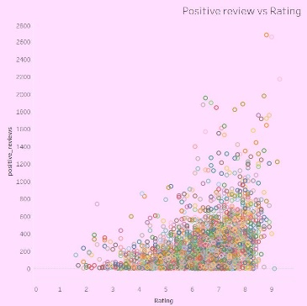
Why do positive reviews matter?
There is a strong correlation between positive reviews and ratings, where an increase in positive reviews tends to coincide with higher ratings. According to my analysis, movies with high positive reviews also tend to perform well at the box office.
([Num User For Reviews] + [Num Critic For Reviews]) / 2

Slide 10
Our Analysis:
Budget Allocation:
Challenge the conventional notion that higher budgets guarantee higher ratings. Consider cost-effective strategies that prioritize viewer experience over budget size.
Genre Selection:
Focus on genres like crime, drama, and action, which consistently receive high ratings. Tailor content to align with audience preferences for increased success.
Viewer Engagement:
Leverage the positive correlation between viewer engagement and ratings. Implement interactive marketing strategies and social media campaigns to enhance audience connection.
Enhanced Viewer Experience:
Prioritize creating enjoyable and engaging content. Factors like plot development and character dynamics significantly contribute to a positive viewer experience.
Marketing and Box Office Success:
Emphasize positive reviews in marketing campaigns to attract a broader audience. Recognize the correlation between positive reviews and box office performance for strategic planning.

Slide 11
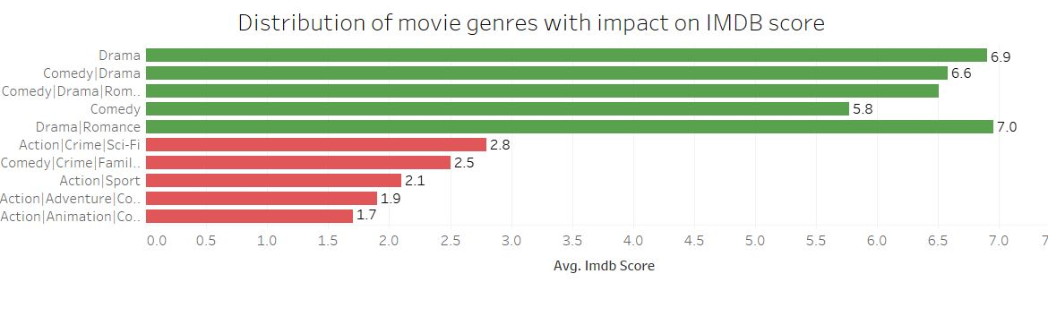
Movie Genre Analysis: Analyze the distribution of movie genres and their impact on the IMDB score?
I visualized the distribution of movie genres against IMDb ratings, employing a set visualization method to highlight the top 10 and bottom 10 genres. The maximum average rating observed was 6.9, while the minimum rating reached 1.7

Slide 12
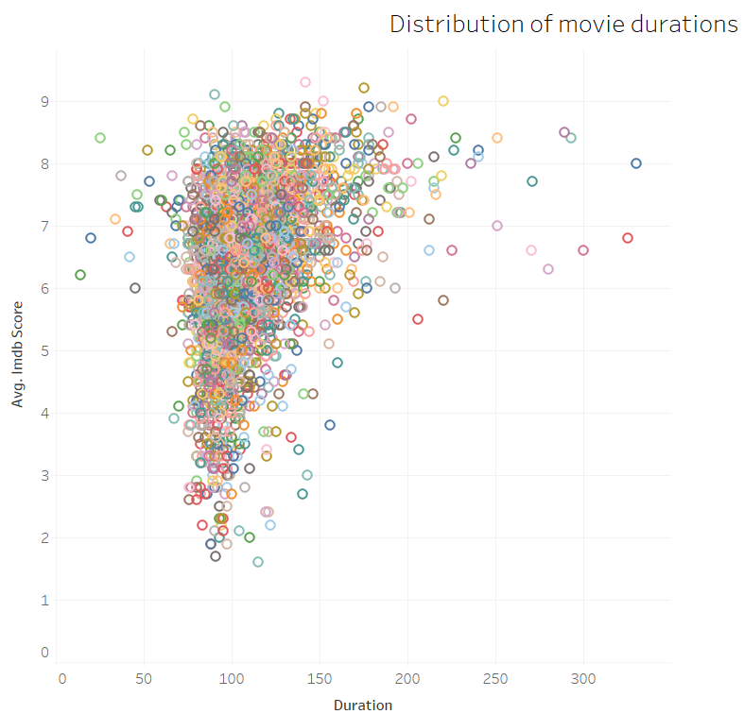
Movie Duration Analysis: Analyze the distribution of movie durations and its impact on the IMDB score?
There is no observed correlation between the duration of a movie and its rating. It seems that the duration does not have a significant impact on the overall rating.

Slide 13
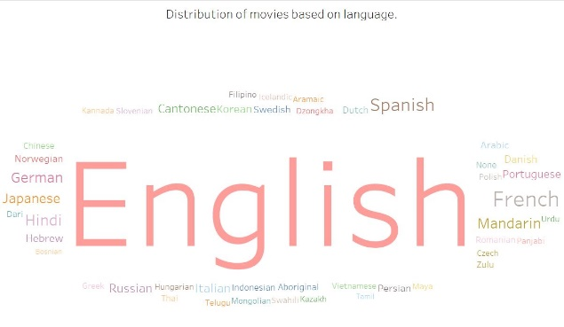
Language Analysis: Situation: Examine the distribution of movies based on their language?
The distribution of movies is predominantly in English, and the IMDb ratings reflect this trend. Among English-language films, the highest IMDb rating recorded is 28,548.

Slide 14
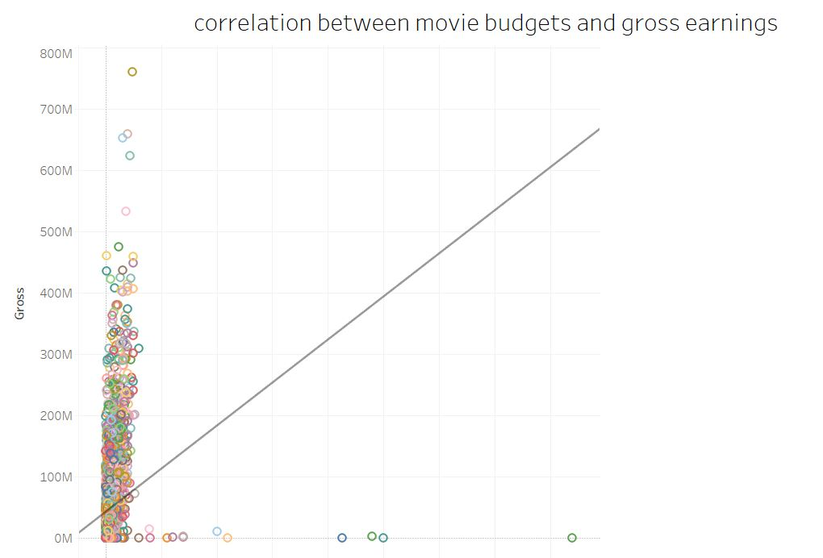
Budget Analysis: Explore the relationship between movie budgets and their financial success?
The distribution of movie budgets and gross earnings reveals no correlation, indicating that the budget is not a reliable predictor of gross earnings. However, there is a strong and positive relationship between positive reviews and gross earnings, suggesting that higher positive reviews are associated with increased gross earnings.

Slide 15
LINK IMDb Rating | Tableau Public Imdb1 | Tableau Public
Director Analysis: Influence of directors on movie ratings?
I computed the IMDb score percentiles to assess and evaluate the performance of directors.

Slide 16
Thank you for your time and attention!

